Slide 1

MUSIC GENRE CLASSIFICTION

Slide 2
DATA SET
https://huggingface.co/datasets/maharshipandya/spotify-tracks-dataset/tree/main
This is a dataset of Spotify tracks over a range of 125 different genres. Each track has some audio features associated with it. The data is in CSV format which is tabular and can be loaded quickly.
The data set has over 114,000 samples, where training samples are 100,000 and testing samples are 14,000

Slide 3
FEATURES IN DATA SET
track_id: The Spotify ID for the track
artists: The artists' names who performed the track. If there is more than one artist, they are separated by a ;
album_name: The album name in which the track appears
popularity: The popularity of a track is a value between 0 and 100, with 100 being the most popular. The popularity is calculated by algorithm and is based, in the most part, on the total number of plays the track has had and how recent those plays are. Duplicate tracks (e.g. the same track from a single and an album) are rated independently. Artist and album popularity is derived mathematically from track popularity.

Slide 4
FEATURES IN DATA SET
duration_ms: The track length in milliseconds
track_name: Name of the track
acousticness: A confidence measure from 0.0 to 1.0 of whether the track is acoustic. 1.0 represents high confidence the track is acoustic
track_genre: The genre in which the track belongs

Slide 5
Data preprocessing
1. DataFrame : A copy of the original DataFrame (`df`) is created and named `df_dt`. This ensures that the data manipulation operations are performed on a separate copy to avoid modifying the original data.
2. Column Removal: Columns that are deemed irrelevant for the analysis are removed from the `df_dt` DataFrame. Specifically, the 'track_id,' 'album_name,' and 'track_name' columns are dropped from the DataFrame.
3. Label Encoding: A `LabelEncoder` object is created to encode categorical data. The 'artists' column is processed to extract the first artist from each entry and remove any leading or trailing spaces. These artist names are then encoded into numerical values.

Slide 6
4. Feature and Target Extraction: The prepared data is split into features (`X`) and the target variable (`y`). The features (`X`) are obtained by dropping the 'track_genre' and 'artists' columns, while the target variable (`y`) is set to the 'track_genre' column.
5. Data Ready for ML: After these preprocessing steps, the data is ready for machine learning tasks. The features are stored in `X`, the target variable in `y`, and the artist information is numerically encoded. This prepared data can be used for tasks such as model training and evaluation.

Slide 7
CLASSIFICATION METHODS:
Currently, we have implemented two classification methods:
1.Decision Tree
2.Naive Bayes Theorm

Slide 8
Decision Tree Algorithm
A decision tree algorithm recursively splits a dataset into subsets based on feature values, aiming to achieve pure (homogeneous) leaf nodes in terms of the target variable.
Libraries Used: Sci-Kit Learn(Decision tree classifier, accuracy, label encoder, confusion matrix), pandas, numpy.

Slide 9
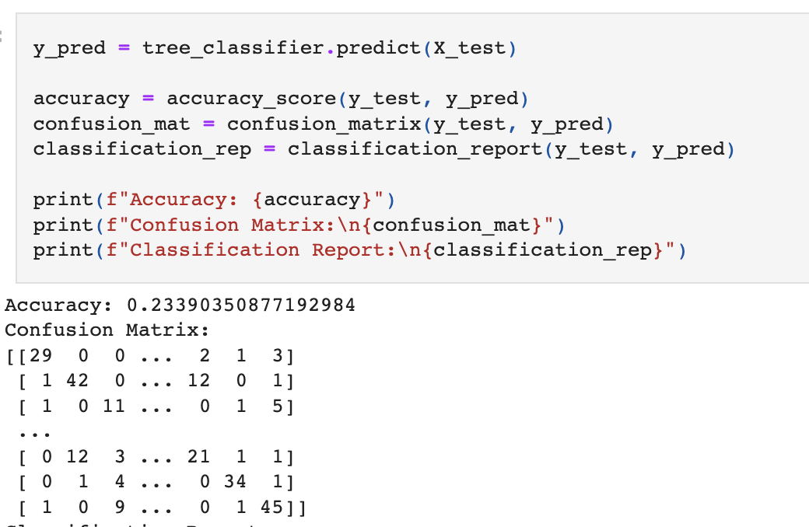
Decision Tree Algorithm - Outputs
We have Implemented descion tree algorithm and calculated the accuracy confusion matrix and classification report.
Since , We are getting 25% accuracy , to improve the accuracy we used different methods like pruning and binning

Slide 10
Decision Tree Algorithm -Outputs
Accuracy after implementing pruning is 21.4%
Let's bin these variables : popularity, duration_ms, danceability, energy, loudness, speechiness, acousticness, instrumentalness, liveness, valence, and tempo. We set the bins based on the data description given in the readme file.
Accuracy after implementing binning method is 17.1%
Even after binning and re-prunning our tree, we still are stuck at below 25% accuracy. Since we have seemingly exhausted our options for improving our tree, we can safely assume that decision tree is not a great algorithm for our goal. Alternatively, maybe our data just is not capable of making a good prediction overall.

Slide 11
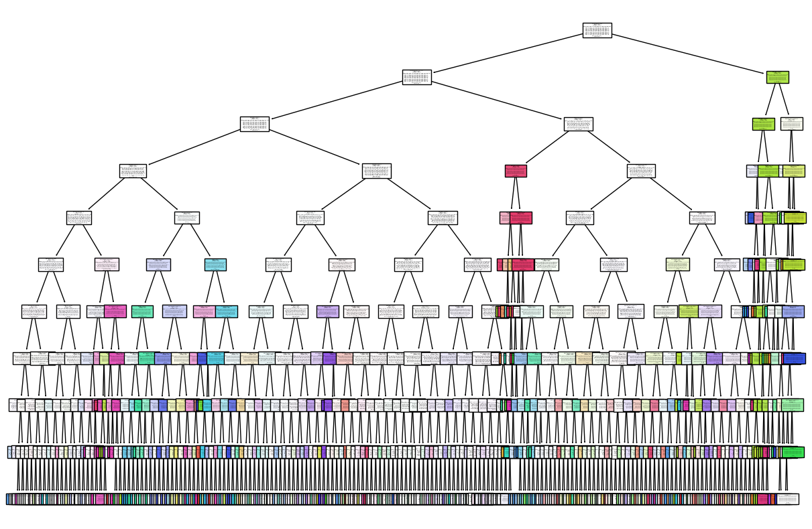
Decision tree

Slide 12
Naive Bayes Algorithm
A Naive Bayes algorithm calculates the probability of a label given a set of features by applying Bayes' theorem, assuming that the features are conditionally independent given the label.
Libraries Used: Sci-Kit Learn(GaussianNB, train_test_split accuracy, label encoder, confusion matrix), pandas, numpy.

Slide 13
Naïve Bayes Algorithm - Outputs
We have Implemented naïve bayes algorithm and calculated the accuracy confusion matrix and classification report.
Accuracy: 0.9655263157894737
Confusion Matrix:
[[107 0 0 ... 0 0 0]
[ 7 97 1 ... 0 0 0]
[ 0 0 108 ... 0 0 0]
...
[ 0 0 0 ... 113 2 0]
[ 0 0 0 ... 3 86 2]
[ 0 0 0 ... 0 1 107]]

Slide 14
Future Plan Of Action:
Try to increase the accuracy for Decsion Tree.
Implement the other three classifiers.

Slide 15
Thank You

